Slide 1
Welcome to Class…
On a half sheet of paper please answer the following questions (If I can incorporate things you like into this class I will):
What do you prefer to be called in class?
What are your favorite movies?
What are your favorite artists or bands?
What are your TV, Netflix, Amazon, Hulu shows?
What is something you’re good at? (“nothing” is not a valid response)?

Slide 2
Economics with Mr. Cook
Today you can sit wherever you like
Funny Clip
Attendance
Class routines
Warm-Up w/ music
Discussion
Technology in Class
Market
Class Breakdown
Exams = 40%
Final Exam = 15%
Projects = 10%
Homework and Classwork = 20%
Participation Project = 15%

Slide 3
Economics with Mr. Cook
Participation project
A finite amount of currency will be available to the class to earn through participation ($87,000)
This is a 25 person class as of now (we will adjust if we need to), so in order to earn 100% on your participation grade, you will need to accumulate $3,000 “Cook Bucks”
I will act as the federal reserve and the bank of our class
Inherently this class will have some who participate more than others, so if those individuals develop a surplus of Cook Bucks that exceeds $3,000, then they are free to spend it on “Market Items”
Every Friday we will cash out and open up the “Market”

Slide 4
Econ with Mr. Cook
Books on Friday 8am
Random Seating Chart
Funny Clip

Slide 5
Warm Up #1
What are the characteristics that make something valuable?
What is the difference between a “need” and a “want”?
Current Event Question: What is the name of the Chinese currency? What happened to the Chinese Stock Market last week? How long is the Chinese Stock Market expected to behave like it is? What did China do to it’s currency in the Fall of 2015? How much global wealth has been lost in the global stock markets in 2016 alone?

Slide 6
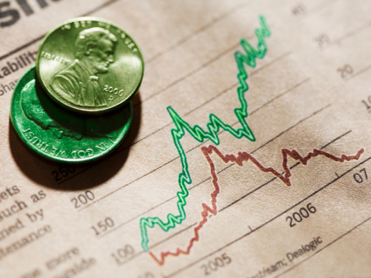
Economics: Chapter 1
Cook
Fall 2017

Slide 7
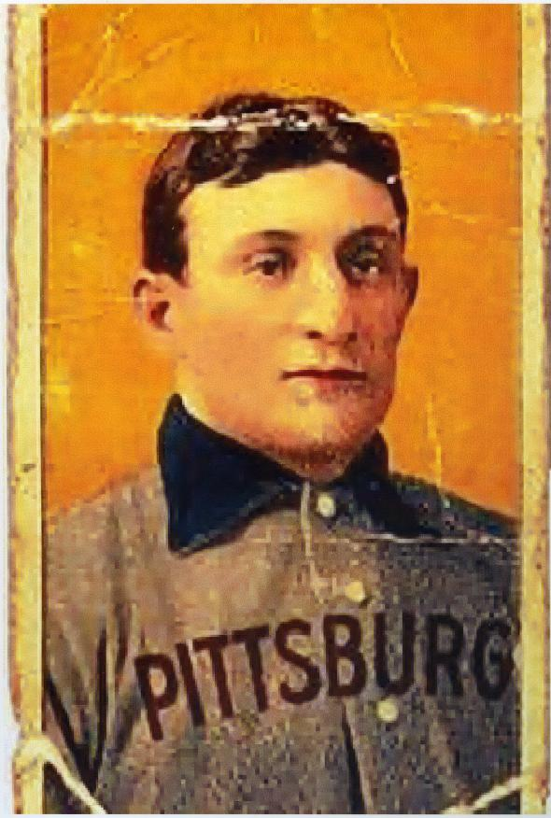
Chapter 1
What is Economics?
The study of how we make decisions
What is the fundamental problem facing all societies?
Scarcity – not having enough resources to produce all things people would like to have
Unlimited (infinite) desires coming into conflict with limited (finite) resources

Slide 8
Warm Up #1
What is scarcity and how does it determine value? Give an example
In economics, what is a “need” vs a “want”? Give an example
What is your favorite economics story?
Notes:
1.3 Trillion
68 billion alone in 2015
$35,000
71%

Slide 9
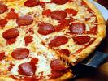
Chapter 1
Need
Basic requirement for survival
Food, shelter, clothing
Want
Things we justify as needs but are not necessarily needed
Pizza is a food and we may want it but there are other basic sources of food that could help us survive just as well

Slide 10
Chapter 1
4 Factors of Production
Resources required to produce the things we would like to have, are land, capital, labor, and entrepreneurs
Land
Anything that is a gift of nature
Forests, mineral deposits, livestock, sunshine etc.
Capital
Tools, equipment, factories and machinery used in the production of goods

Slide 11
Chapter 1
Financial Capital
Money used to buy the tools and equipment used in production
Labor
People with all their efforts, abilities and skills
Entrepreneur
A risk taker in search of profits who does something new with existing resources

Slide 12
Chapter 1
Production
The process of creating goods or services
GDP
Gross Domestic Product – The dollar value of all final goods and services in a 12 month period within the U.S.
GNP
Gross National Product – Measures the wealth of all citizens in a 12 month period whether its in the U.S. or outside our borders

Slide 13
Warm Up #2
What is GNP? GDP? How do they differ?
What are the (4) factors of production?
What it is the economic definition of Capital? Labor?
CEQ: What are economic sanctions? What countries do the United States and/or NATO have economic sanctions against? Why?

Slide 14
Chapter 1
Goods
Consumer Goods – product designed for use by consumers
Capital Goods – product designed for use by manufacturers
Services
Work that is performed by someone
Consumer
A person who uses goods and/or services

Slide 15
Chapter 1
Paradox of Value
Why is water virtually free when we need it and diamonds are expensive and have no particular use?
The situation where some necessities, such as water, have little monetary value, whereas some non-necessities, such as diamonds have a much higher value

Slide 16
Chapter 1
Utility – The capacity to be useful and provide satisfaction
Factor Markets – The markets where productive resources are bought and sold
Product Markets – Markets where producers sell their goods and services to customers
Economic Growth – occurs when a nation’s total output of goods and services increases over time.

Slide 17
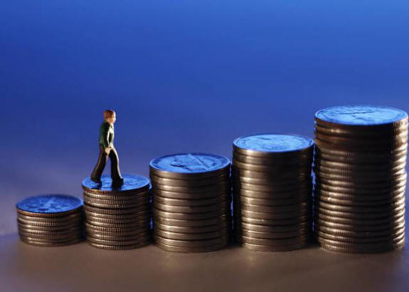
Chapter 1
Productivity – A measure of the amount of output produced by a given amount of inputs in a specific amount of time.
If a company produced 500 units of one product in a year and the next year produced 510 units without changing their inputs then their productivity went up.

Slide 18
Chapter 1
Wealth – The accumulation of products that are tangible, scarce, useful and transferable from one person to another
Circular Flow of Economic Activity – Page 15 and handout

Slide 19
Chapter 1
Division of Labor – Work is arranged so that individual workers do fewer tasks than before
Specialization – When factors of production perform tasks that they can do more efficiently than others
Human Capital – The sum of skills, abilities, health and motivation of people
Economic Interdependence – When companies or countries rely on one another to provide goods and services

Slide 20
Warm Up #4
What is the difference between GNP and GDP? Which is a better indicator of the health of the United States? Which is a better indicator of the wealth of United States citizens?
If the population increases roughly 1% every year, how much economic growth is required to maintain the standard of living for everyone?
Draw and label the circular flow model.
CEQ: What has happened to the water of Flint Michigan? What led to this? Has this led to a higher or lower standard of living in Flint?
Notes:
3.1 million
Domestic = within the border

Slide 21
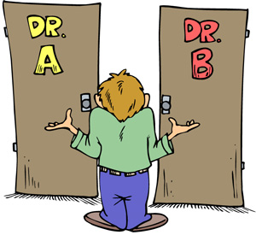
Chapter 1
Opportunity Cost
Cost of the next best alternative
It is what you give up
Money, time or resources when one choice is made over another

Slide 22
Chapter 1
Production Possibilities Frontier (PPF or PPC) – A diagram representing various combinations of goods and/or services an economy can produce when all productive resources are fully employed
Economic growth expands production possibilities

Slide 23
Warm Up
What is Economics?
What’s the difference between a need and a want?
What is the fundamental problem facing all societies?
What are factors of production?
What is an opportunity cost?
What does PPC stand for? What’s another name for a PPC graph?
PPC Problem on Board
CEQ: What has happened to the water of Flint Michigan? What led to this? Has this led to a higher or lower standard of living in Flint?

Slide 24
Warm Up
What is Specialization in terms of economics?
What is the Division of Labor? Name an example.
Why is economic growth important? How does everyone benefit when the economy is growing?
PPC Problem on board – Graph
Plot a point and label it “F” – This point is not utilizing full efficiency.
Plot a point and label it “G” – This point is unachievable without a new variable
What is a new variable that could shift our curve to point “G”?

Slide 25
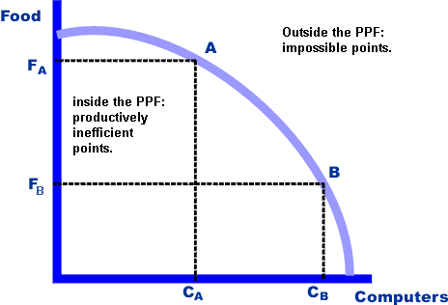
Production Possibilities Curve

Slide 26
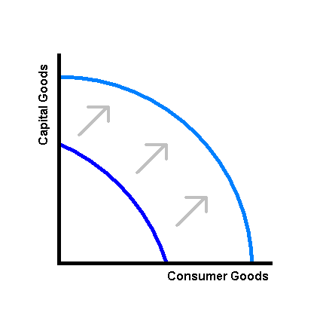
PPF/PPC Growth

Slide 27
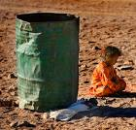
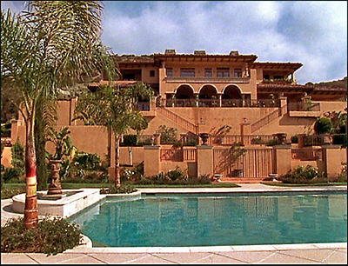
Chapter 1
Cost-benefit analysis – A way of thinking about a problem that compares the costs of an action to the benefits received
Standard of Living – The quality of life based on the possession of the necessities and luxuries that make life easier

Slide 28
Chapter 1
Free Enterprise Economy (Market Based) – one of which consumers and privately owned businesses, rather than the government make the majority of economic decisions (U.S.)

Slide 29
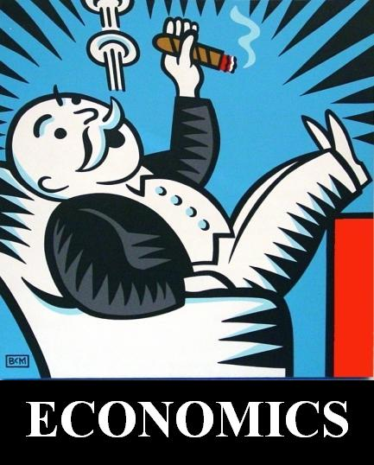
Economics: Chapter 2
Cook
Fall 2017

Slide 30
Chapter 2
Economic System – Organized way in which a society provides for the wants and needs of its people

Slide 31
Types of Economy
Free Enterprise Economy (Market Based) – one of which consumers and privately owned businesses, rather than the government make the majority of economic decisions (U.S.)
Tradition Based Economy – People repeat the decisions of previous generations (India)
Command Based Economy – Decisions are made by an authority figure (Cuba, Soviet Union, China)

Slide 32
Types of Economy
Market Economy – Capitalism or Free Market
Advantages – Can adjust to change, Individual Freedom, Small amount of govt. interference, decentralized
Disadvantages – Does not provide for the basic needs of everyone within it’s society, Does not provide enough services that people value, High degree of uncertainty and large swings occur regularly

Slide 33
Types of Economy
Traditional
Advantages – Everyone knows their role in the economy
Disadvantages – Discourages innovation and new ideas, Low standard of living

Slide 34
Types of Economy
Command Economy
Advantages – Can change direction drastically in a short amount of time, Health and Public services provided for everyone
Disadvantages – Does not meet the wants of consumers, No incentive to work hard, Not very flexible

Slide 35
Economic and Social Goals
Social Security – A federal program of disability and retirement benefits that covers most working people
Inflation – A rise of the general level of prices. Occurs when workers need more money to pay for food, clothing, and shelter

Slide 36
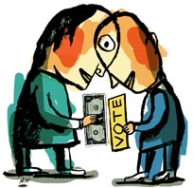
Chapter 2
Fixed Income – An income that does not increase even though prices go up
Voluntary Exchange – The act of buyers and sellers freely and willingly engaging in market transactions. Mutually beneficial

Slide 37
Warm Up #5
Name at least one advantage and one disadvantage of the following types of economies:
Command
Traditional
Market Based
What is the Paradox of Value?
Draw the circular flow model.
Who is known as the “Father of Capitalism”? What did he write? What was his view on government intervention in the economy?
CEQ: I lied, this isn’t going to be about China’s Stock Market. Who is currently polling in 3rd place in our National Presidential Election?

Slide 38
Capitalism and Economic Freedom
Private Property Rights – The privilege that entitles people to own and control their possessions as they wish
Profit – The extent to which persons or organizations are better off at the end of a period of time

Slide 39
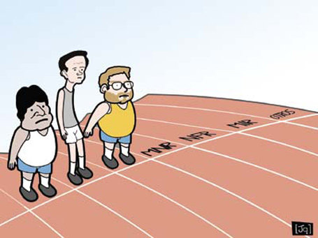
Chapter 2
Profit Motive – The driving force that encourages people and organizations to improve their material well-being
Competition – The struggle among sellers to attract consumers while lowering costs

Slide 40
Capitalism and Economic Freedom
Consumer Sovereignty – The role of the consumer as sovereign or ruler of the market (The customer is always right)
Mixed Economy – Consumers carry on with their economic affairs freely but are subject to some government intervention and regulation

Slide 41
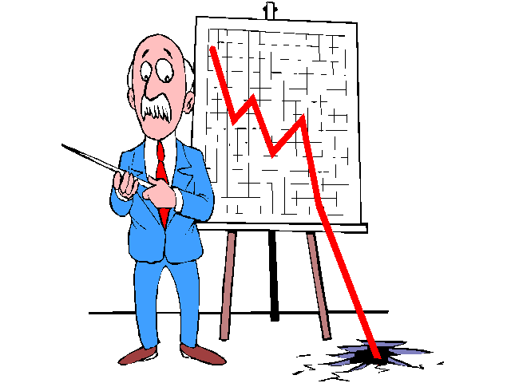
Microeconomics
Branch of economic theory that deals with behavior and decision making by small units such as individuals and firms

Slide 42
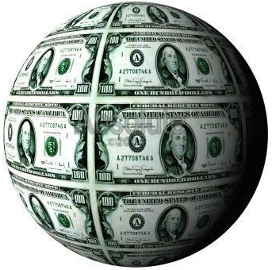
Macroeconomics
Branch of economic theory dealing with the economy as a whole and decision making by large units like government

Slide 43
All Content Created by DJ Cook

